Slide 1
A practical guide to administering Goal Attainment Scaling © 2023 by Benignus Logan (University of Queensland: Centre for Health Services Research - Australian Frailty Network) is licensed under CC BY-NC-ND 4.0. To view a copy of this license, visit http://creativecommons.org/licenses/by-nc-nd/4.0/
Permission for use
You may copy, distribute, display, download or otherwise freely deal with this work for any non-commercial educational, clinical or research purpose, provided that it is unaltered and you attribute the author.

Slide 2
Goal Attainment Scaling
Notes:
Actions prior to commencing the training:
Send each participant the GAS Training manual 3-5 days prior and suggest they print a copy should they wish to have a hardcopy to write notes on
Advise participants they need their own computer for the training (works better not to share given the breakout groups)
Allocate breakout groups, and update slide to reflect this
Send out the simulation scenario files (instructions, and the relevant “role briefings” sheet) to each participant individually the morning of the training
______________
Welcome!
Introduce self
Before we begin, can I check everyone has:
A pen and paper, or an electronic notepad
A copy of the material that was sent out either as a hard copy or an easily accessible soft copy

Slide 3
Acknowledgment of Country
The University of Queensland (UQ) acknowledges the Traditional Owners and their custodianship of the lands on which we meet.
We pay our respects to their Ancestors and their descendants, who continue cultural and spiritual connections to Country.
We recognise their valuable contributions to Australian and global society.

Slide 4
Notes:
The purpose of this training is to prepare YOU to feel ready to complete the GAS process with patients.
Given today is all about you and your needs, I encourage you to stop me with any questions as they arise. Either I will answer them then or note them to cover later (whichever is more appropriate).
You may wish to have the GAS Training Manual open as we progress through today’s training to write notes as required.

Slide 5
Objectives
Introduce Goal Attainment Scaling (GAS)
Explain the importance and benefits of goal setting
Discuss SMART goals
Overview the GAS template
Describe how to set and scale a goal for GAS
Suggest how to conduct meetings with patients
Allow an opportunity for practical simulation
Offer tips on troubleshooting common challenges
Describe the review and scoring process
Notes:
My objectives for the training are (read from slide; **reveal line by line**)

Slide 6
LEARN
PRACTICE
REFLECT
PRACTICE
DO!
Today
Within 1-2 weeks
Notes:
More graphically, our training is structured as follows:
Learn (learn the theory and the processes)
Practice (simulation exercises in breakout groups today) (Both of these first things will occur today)
Reflect (period of reflection to further digest today’s material, and have the opportunity to read through the training manual and note any questions)
Practice (a further practical simulation one-on-one with myself or Bonnie; this also allows for answering any questions you have) (These two things will occur in the coming fortnight, pending our mutual availability)
Do (you will be ready to go live and see patients)
There is a limit as to how much we can “teach” you today, hence a degree of self-directed reading and learning is required.

Slide 7
LEARN
PRACTICE
REFLECT
PRACTICE
DO!
Today
Within 1-2 weeks
Notes:
We will now begin with the theory components of our training

Slide 8
Objectives
Introduce Goal Attainment Scaling (GAS)
Explain the importance and benefits of goal setting
Discuss SMART goals
Overview the GAS template
Describe how to set and scale a goal for GAS
Suggest how to conduct meetings with patients
Allow an opportunity for practical simulation
Offer tips on troubleshooting common challenges
Describe the review and scoring process

Slide 9
Notes:
GAS is a tool which documents a patient’s goal, and then scores the extent to which they are attained.
Goals are unique to the patient and their situation.
The GAS process was first developed in the 1960s, and has been deployed in a wide range of research and clinical settings. It is most frequently used in geriatric and general rehabilitation medicine, but also in paediatrics, community health, pain medicine, mental health and haematology.

Slide 10
Goal Attainment Scaling
Step | Detail
1 | Identify a goal
2 | Define the current state
3 | Identify potentially better and worse outcomes
4 | Weight the goals
5 | At follow-up, compare the current status with baseline status
Notes:
The basic steps are

Slide 11
Stakeholders
Facilitator
Caregiver
Patient
Clinicians
Researchers
Notes:
There are several stakeholders involved in the GAS process
**REVEAL**
Patients – the most important stakeholder in this exercise
Facilitator – that’s you! Someone who partners with the patient through the process
Caregivers – a possible valuable resource for collateral history and support (A support person is welcome to attend the GAS meetings at the patient’s request/consent)
Clinicians – important in clinical settings, but for this trial’s design they are not involved in this process
Researchers – the output of the GAS process will be an outcome for research
ANY QUESTIONS?

Slide 12
Objectives
Introduce Goal Attainment Scaling (GAS)
Explain the importance and benefits of goal setting
Discuss SMART goals
Overview the GAS template
Describe how to set and scale a goal for GAS
Suggest how to conduct meetings with patients
Allow an opportunity for practical simulation
Offer tips on troubleshooting common challenges
Describe the review and scoring process

Slide 13
Benefits and importance of goal setting
Focusing on individually-desired results
Measures meaningful change
Supports shared decision-making
Unifies attention on individualised outcomes
Notes:
Something you may have come across is the concept of patient-centred care.
It is something which is gaining prominence, and increasingly recognized as important for patients.
Patient-identified goals are needed to underpin patient-centred care.
The benefits of involving patient in their care, through goal setting, include:
**REVEAL**
Focusing on individually-desired, rather than system-set results
Measuring, and thus allowing praise of, meaningful changes achieved by a patient
Providing a tool for collaboration and communication between patients and their healthcare profressional in the interests of shared decision-making
Unifying attention on individualized outcomes rather than potentially disparate and conflicting disease-specific outcomes
We have sought to highlight the benefits of goal setting in a number of ways through the GAS process (specifically in the patient information sheet, and in the conversation starters) so that patients can be disposed to seeing GAS favourably from the outset.
ANY QUESTIONS?

Slide 14
Objectives
Introduce Goal Attainment Scaling (GAS)
Explain the importance and benefits of goal setting
Discuss SMART goals
Overview the GAS template
Describe how to set and scale a goal for GAS
Suggest how to conduct meetings with patients
Allow an opportunity for practical simulation
Offer tips on troubleshooting common challenges
Describe the review and scoring process

Slide 15
S M A R T
Notes:
Goals should meet the SMART criteria
Specific
Measurable
Achievable
Relevant
Timebound

Slide 16
S M A R T
Specific
Notes:
Goals should meet the SMART criteria
SPECIFIC
Needs to be clear what the problem or desired change is being targeted
If a goal is “to walk better” – does that mean: walk a longer distance, walk without an aid, or walk without any pain
If all three are important, then separate them into three goals

Slide 17
S M A R T
Measurable
Notes:
MEASURABLE
Each goal needs an objective measure
Objective measures are easy to determine where the goal can relate to a frequency (“cook dinner three nights a week”) or distance (“cycle ten kilometres”).
Sometimes a degree of subjectivity has to be accommodated. For example, whilst “have less pain” may be seen as subjective, it can be made more objective by reframing it as “reduce my pain levels from 8/10 with activity, to 4/10 with activity” or “use only one 5mg oxycodone a day”.

Slide 18
S M A R T
Achievable
Notes:
ACHIEVEABLE
Patients, with prompting from their facilitator, will have to consider how achievable their desired goal is.
Important considerations include reflecting on when they last were able to achieve that outcome and how far from being able to do it now.
For example, if their goal is to walk 50 metres it would be important to probe when they last walked that far and to understand how far they comfortably walk now.

Slide 19
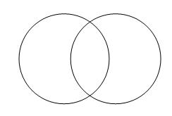
S M A R T
Relevant
Notes:
RELEVANT
Goals should be of relevance to the patient, and given they are setting them they intuitively should be.
It is not necessary for a carer or clinician to endorse its relevance.
The facilitator may wish to prompt the patient to reflect on the benefit or purpose that attaining the goal would bring.

Slide 20
S M A R T
Timebound
Notes:
TIMEBOUND
The date for achieving the goal needs to be stated. The patient should consider whether their goal is something which is likely to occur in the time period available.
The date for achieving the goal is to be three months, in keeping with the trial’s primary outcome measure.
Please note you do not revise any goals at three months.

Slide 21
Objectives
Introduce Goal Attainment Scaling (GAS)
Explain the importance and benefits of goal setting
Discuss SMART goals
Overview the GAS template
Describe how to set and scale a goal for GAS
Suggest how to conduct meetings with patients
Allow an opportunity for practical simulation
Offer tips on troubleshooting common challenges
Describe the review and scoring process

Slide 22
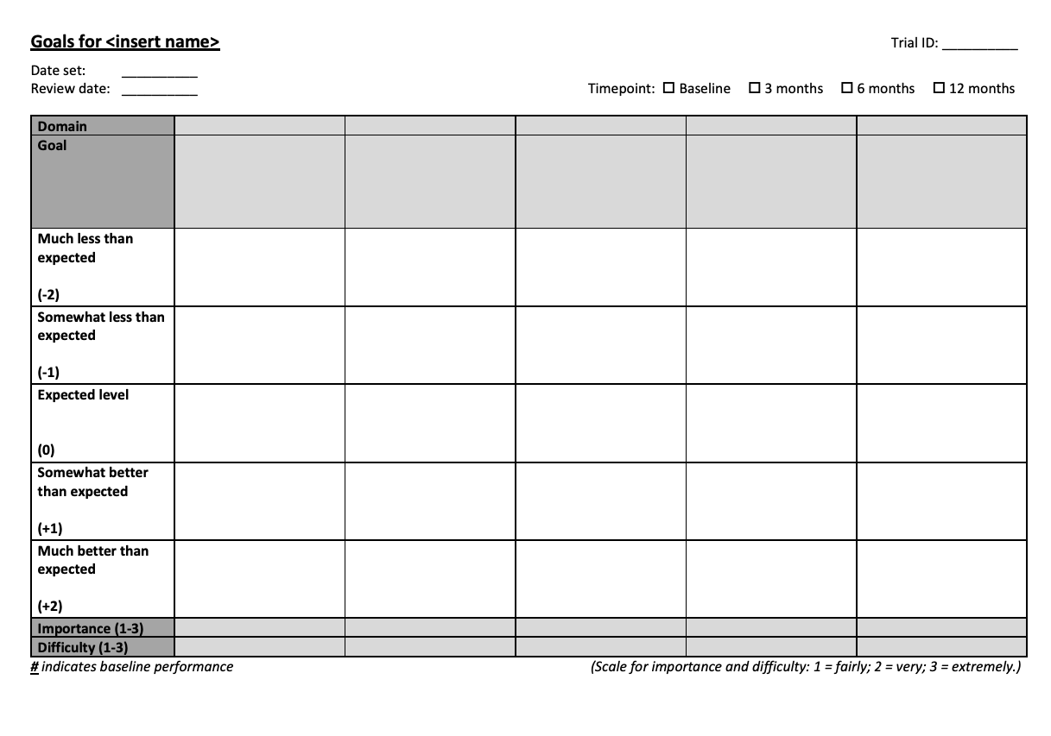
Notes:
This is the template to be used. If you open Appendix A in the training manual you can see it there too.
It will be ideally printed and worked through as a paper-based version. Where required though, it can be shared on a screen in a Zoom call.
It is best to explain to the patient at the outset that this template is a useful way to conceptualize the GAS tool (i.e. gives them context as to the scaling process)
Let’s now work through the various elements of it to orient you to it….

Slide 23
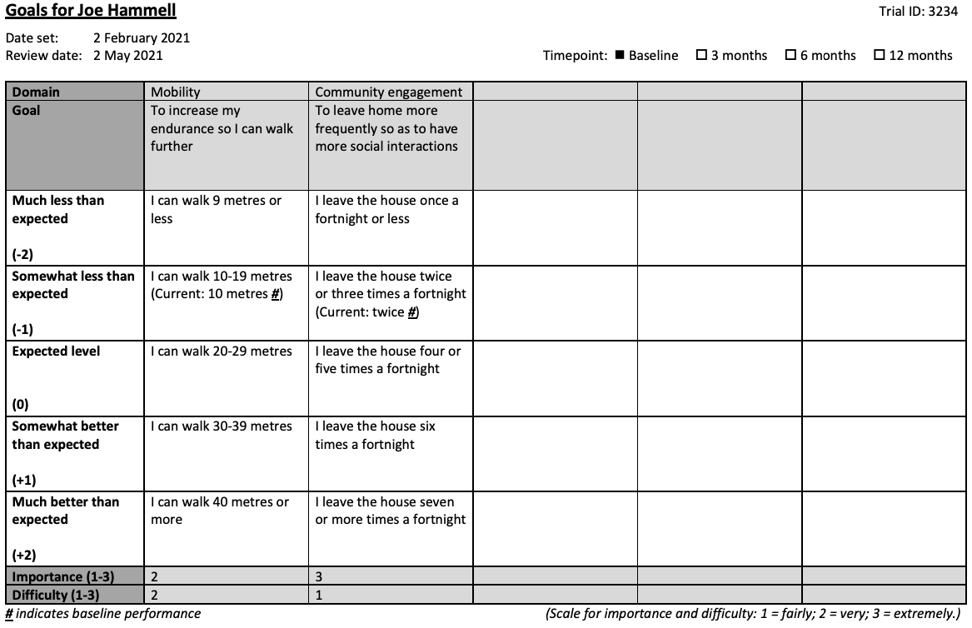
Notes:
We will use a populated template to help with the orientation being more easily understood.
This is Appendix B.

Slide 24
Notes:
At the top, there is space to note the patient’s name as well as the day’s date.
The review date should be noted as three months from the date the goals are set.

Slide 26
Notes:
The goal is written in plain language

Slide 27
Notes:
The goal domain which best matches the goal should be listed
We will discuss more about the goal domains shortly

Slide 28
Notes:
The bulk of the table provides space, as shown below, for the baseline and attainment measures to be articulated in detail.
The measures correspond to a numerical score as follows:
Much less than expected: -2
Somewhat less than expected: -1
Expected level: 0
Somewhat better than expected: +1
Much better than expected: +2

Slide 29
Notes:
The bottom part of the table prompts for a weighting to be recorded with respects to each goal’s importance and perceived difficulty according to the patient.
The weighting ranges from 1 for a “fairly” important or difficult goal, through to 3 for an “extremely” important or difficult one, and should be determined by the patient.

Slide 30
Notes:
Remember to place a # where the baseline performance is
Where there is a range, in the case of a continuous variable being used, then write the baseline out separately
ANY QUESTIONS?

Slide 31
Objectives
Introduce Goal Attainment Scaling (GAS)
Explain the importance and benefits of goal setting
Discuss SMART goals
Overview the GAS template
Describe how to set and scale a goal for GAS
Suggest how to conduct meetings with patients
Allow an opportunity for practical simulation
Offer tips on troubleshooting common challenges
Describe the review and scoring process

Slide 32
Notes:
Self-reflection is important for setting goals that are relevant to the patient.
To prompt this desired self-reflection, a preparation information sheet on goal setting will be issued prior to the meeting.
The information sheet is shown on the screen, but please see Appendix C.
This preparation information sheet will be issued after a patient has been consented and confirmed as being eligible for the trial.
The intent for the information sheet, along with how it is introduced, is to leave the patient in a positive mindset as they approach the goal-setting meeting, and to give them adequate time to think about what they may like to achieve.

Slide 33
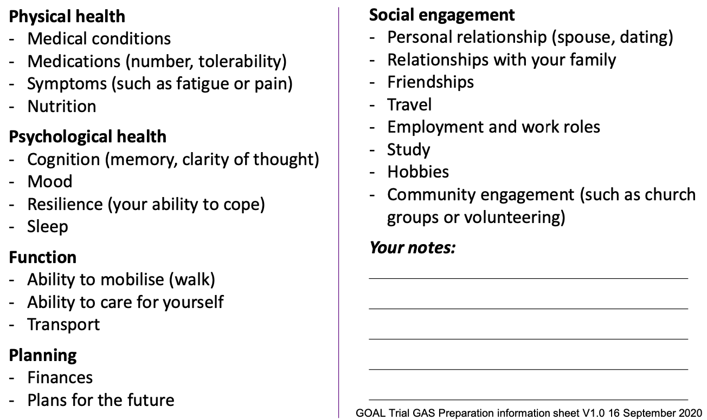
Goal domains
Notes:
Whilst you can read over the patient information sheet in your own time, I wanted to highlight the goal domains.
They are useful to help identify areas in which they may wish to consider setting goals.

Slide 34
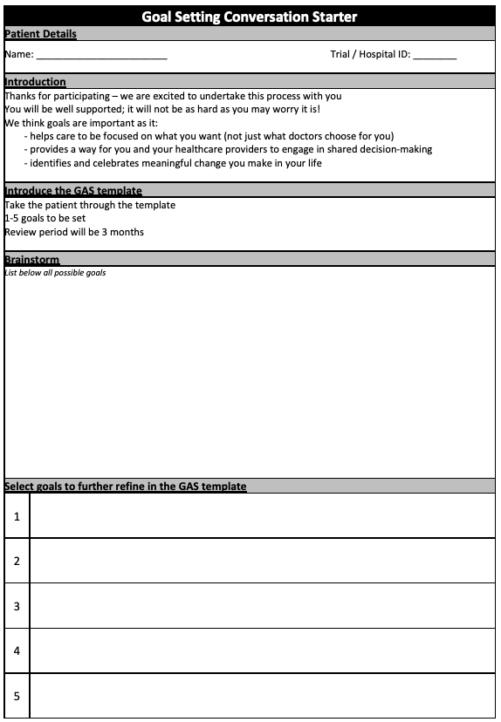
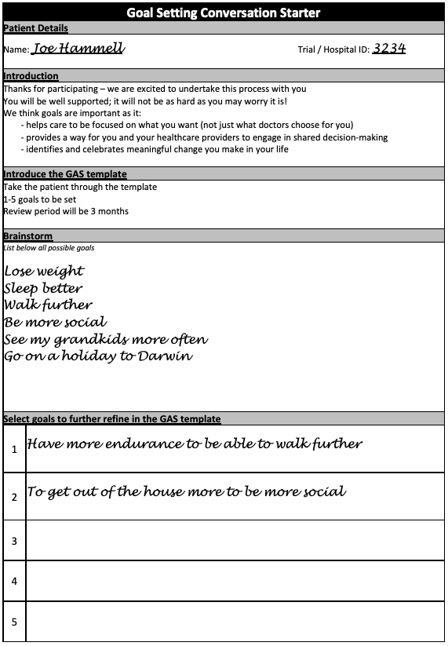
Notes:
We will now turn our attention to Appendix D and E in the training manual.
This is a conversation starter, and a great tool for you to get the patient talking about what they may wish to set a goal in.
Brainstorming ideas may be easy for some, but for other patients it may take more prompting and support.
There should be no judgement or moderation attempts made at this initial stage. Write down everything they say no matter how unworkable it may seem.
Refer back to the goal domains on the GAS preparation information sheet if the patient gets stuck.
The training manual offers some other prompting questions as well.
After the brainstorming is completed, move on to listing 1-5 goals to be set.
ANY QUESTIONS?

Slide 35
Set and scale a goal
Describe a measure
35
Notes:
Once you have identified one to five goals, it is time to formally set and scale them.
Before you put pen to paper on the GAS template you will need to ensure the goal has a SINGLE measure. For example if a patient wishes to “walk better”, the facilitator will need to agree with the patient how that is best measured.
It may be:
walking a longer distance (metres as a measure), or
mobilise more independently (level of assistance as a measure)
There cannot be multi-faceted measures in the one goal (i.e. ‘metres’ and ‘level of assistance’). Should the patient have two measures that are identified as important to them, then two separate goals should be set.
Also key to describing a measure, is ensuring it can be scaled to five different intervals.
For continuous measures, such as distance, this is relatively straightforward.
Drawing on the above goal of “walking a longer distance”, the five intervals could be scaled as: 80 metres; 60 metres; 40 metres; 20 metres; and 5 metres or less.
For continuous measures (such as distances), measures should be provided in ranges
For categorical measures this is more challenging but can often be achieved with some thought.
Drawing on the above example of “mobilise more independently”, the five intervals could be scaled as: able to mobilise without any mobility aid; mobilise with a single-point stick; mobilise with a four-wheeled walker; mobilise with a wheelchair via a stand-pivot transfer; and, patient bed bound, requiring a hoist.

Slide 36
Set and scale a goal
Describe a measure
Write the goal and domain
36
Notes:
Once an appropriate measure is identified, the facilitator should now write the goal in the template in the “Goal” row.
The goal should be written in plain language. In this part of the form it is not necessary to write a SMART goal, as the elements of that are set out elsewhere (specifically, in the scaling outcomes and the setting of a review date).
At this time, you should also populate the “Domain” with the single most relevant option available.

Slide 37
Set and scale a goal
Describe a measure
Write the goal and domain
Define baseline performance
37
Notes:
Once the goal is written, have the patient articulate their current performance.
An accurate understanding of their baseline performance is needed so expected outcomes are appropriately set. It is important to appreciate what occurs most often, not what they do sometimes “on a good day”.
It is also key to understand the recency of their performance, and its trajectory. For example, is their ability to walk 20 metres something that has been stable for some months, or is it a new high or low point? It is also worth prompting the patient to share what they were able to do three months ago.
The baseline performance will be written in the “somewhat less than expected (-1)” row.
One exception to this is where there is no conceivable worse outcome than their current status. For example, if their broad goal is “to exercise more” and currently they do no exercise, then that would be written in the “much less than expected (-2)” row.
Another exception is where a patient has experienced a progressive decline in how they are performing in a particular aspect of their life. They may want focus on maintaining their current abilities and halt a deterioration. For example, a patient with kidney failure may have as their goal “to maintain a healthy body weight” in the setting of having lost one kilogram of weight for each of the past six months. For them it may be appropriate to set their baseline measure at the “expected level (0)” row.
Baseline performance is marked on the template by placing a hashtag (#) in the relevant box. Where continuous measures are used, and thus you need a range spelling out the actual current baseline as a discreet measure may be appropriate and reflected in the examples in this document.

Slide 38
Set and scale a goal
Describe a measure
Write the goal and domain
Define baseline performance
Define worse outcomes
38
Notes:
Once the baseline performance is defined, poorer performance outcomes can be articulated.
This will be populated into the “much less than expected” row, unless the baseline performance is at that level.

Slide 39
Set and scale a goal
Describe a measure
Write the goal and domain
Define baseline performance
Define worse outcomes
Define the expected outcome
39
Notes:
The most challenging part of the scaling process is working with the patient to describe expected performance. It is further complicated in situations where the goal relates to an area in which the facilitator may not be familiar. For example, setting goals to “walk further” or “walk with mobility aids” when the facilitator has no rehabilitation or physiotherapy exposure.
The complexities of this stage of the GAS can be addressed by:
Understanding their current and prior performance levels, and the trajectory of this.
Gently challenging the patient on what they see as being a stretch or comfortable for them.
Seeking collateral history from any support person present at the goal setting session.
There is a fine balance in not being too lenient or too firm, particularly in research settings where the GAS is being used as an outcome measure.
For this trial there is no input sought or accepted from the patient’s treating medical and allied health team, as it risks contaminating the trial results.

Slide 40
Set and scale a goal
Describe a measure
Write the goal and domain
Define baseline performance
Define worse outcomes
Define the expected outcome
Define better outcomes
40
Notes:
Once the expected outcome is populated, attention can turn to defining what outcome would be “somewhat better” and “much better” than expected.
Appropriate intervals between the measures should be chosen to ensure the spread between “much less than expected (-2)” and “much better than expected (+2)” is relatively spaced.

Slide 41
Set and scale a goal
Describe a measure
Write the goal and domain
Define baseline performance
Define worse outcomes
Define the expected outcome
Define better outcomes
Set a review date
41
Notes:
Whilst the exact date of review may vary slightly in the reality of arranging review appointments, the review date should be written as three months from the date goals are written down.

Slide 42
Set and scale a goal
Describe a measure
Write the goal and domain
Define baseline performance
Define worse outcomes
Define the expected outcome
Define better outcomes
Set a review date
Nominate a weighting
42
Notes:
The weighting for each goal should now be assigned. A score is required for difficulty and importance, as the patient perceives it. Both the difficulty and importance use the same scale:
1: Fairly important/difficult
2: Very important/difficult
3: Extremely important/difficult
ANY QUESTIONS?

Slide 43
Action plan
Smaller steps to aim for in achieving the ultimate goal
Build potential changes into daily routines
Consider informal and formal resources to access
Notes:
Once a goal is formulated, setting out to achieve it is the next phase.
In order to make an action plan, a patient may want to consider (**REVEAL EACH POINT**):
what smaller steps they can aim for as they work towards the ultimate achievement of a goal,
how to build the potential changes needed into their daily routines, and
the informal and formal resources they can utilise (be it family supports, free online learning, input from their General Practitioner, or accessing the services of a physiotherapist etc).
To ensure there is no contamination of measuring the intervention’s effect, you will not spend time developing an action plan.
You can provide verbal guidance, but only by using the three talking points noted above.
We recognize this is challenging given your likely natural inclination to be helpful, but it is imperative for the integrity of the trial’s results.
ANY QUESTIONS?

Slide 44
Objectives
Introduce Goal Attainment Scaling (GAS)
Explain the importance and benefits of goal setting
Discuss SMART goals
Overview the GAS template
Describe how to set and scale a goal for GAS
Suggest how to conduct meetings with patients
Allow an opportunity for practical simulation
Offer tips on troubleshooting common challenges
Describe the review and scoring process

Slide 45
Conducting a meeting to set goals
t
45 mins for GAS
Face-to-face
Set 1-5 goals
3 month review
Notes:
The GAS Training Manual sets out in detail the actions to take before, during and after the meeting.
Some of the key points (**REVEAL**):
You should set aside 45 minutes for GAS
Ideally have the meeting face-to-face
Set 1-5 goals
3 month review

Slide 46
Conducting a goal setting meeting
Strike the right tone
Offer reassurance
Reiterate the importance of goal setting
Use the provided resources
After the meeting:
Input into REDCap
Redact all personal details prior to scanning
Goals are not for distribution
Notes:
A ”conversation guide” is built into the GAS Training Manual
In the meeting it is important to (**REVEAL**):
Strike the right tone - share a sense of excitement for the session, but be yourself
Offer reassurance they will be well supported through the process – there is a good structure being used
Reiterate the importance of goal setting – using the points highlighted on the resources
Use the provided resources – including the conversation starter handout, the GAS preparation sheet handout, and the talking points in the GAS Training Manual
If you are meeting virtually, Appendix F provides a combination of the brainstorming tool with the GAS template to save switching between multiple documents.
After the meeting (**REVEAL**):
Input the data into REDCap AND scan the completed GAS Template into REDCap
Must redact the form of all personal details before scanning it into REDCap as it risks breaching patient confidentiality otherwise
The document will NOT be issued to either the patient, or their clinicians
Patient can write their own notes.
Patients can NOT take photos with their handheld devices.
ANY QUESTIONS?

Slide 47
Notes:
Time for a quick break!
STAND UP! SPIN AROUND!

Slide 48
LEARN
PRACTICE
REFLECT
PRACTICE
DO!
Today
Within 1-2 weeks
Notes:
To recap, we have undertaken the theory component, so now it is time for some practice

Slide 49
Objectives
Introduce Goal Attainment Scaling (GAS)
Explain the importance and benefits of goal setting
Discuss SMART goals
Overview the GAS template
Describe how to set and scale a goal for GAS
Suggest how to conduct meetings with patients
Allow an opportunity for practical simulation
Offer tips on troubleshooting common challenges
Describe the review and scoring process

Slide 50
Simulation scenarios
Breakout groups of 2-3 people
Rotate through the “facilitator” role
Use the tools in the GAS Training Manual
Timing:
Planning – 5 minutes
”Meeting” to set goals – 10 minutes
Reflection and feedback – 5 minutes (Facilitator to be timekeeper)
Notes:
**REVEAL**
I will shortly place you in breakout groups of 2-3 people.
**REVEAL**
You will each have a chance to be the “facilitator” to have practice in walking a patient through the process of setting goals.
We know that simulation scenarios have their limitations, but try your best to contribute to the fidelity of the exercise.
**REVEAL**
Utilise the GAS Training Manual – specifically the GAS preparation information sheet and the conversation starter document.
**REVEAL**
Timing allowed for this exercise is:
5 minutes of planning
10 minutes of a meeting
5 minutes of reflection and feedback
Facilitator to keep time
ANY QUESTIONS?

Slide 51
Reflection and feedback
Facilitator to share their self-reflections first
Patient and observer roles to then share their feedback
Suggested structure:
Stop doing
Start doing
Keep doing
Notes:
At the end of the simulation, you will have the chance to self-reflect and offer feedback.
**REVEAL**
The person playing the facilitator role should offer their own self-reflections first. This is the followed by the ”patient” and the “observer”.
**REVEAL**
A way you can approach this is via the “Stop doing, Start doing, Keep doing” method.
Think about:
What worked well and should keep doing
What didn’t work well and should not continue
What was not done that could begin being done in the future

Slide 52
Simulation scenario – One
Group | Facilitator | Patient
A
B
C
D
TO POPULATE BASED
ON ATTENDEES
Notes:
SLIDE TO BE POPULATED BASED ON ATTENDEES
If there are uneven numbers, then trainer to pair up with a participant.

Slide 53
Notes:
Time for huddle! Let’s share some reflections
(Ask the group for their thoughts on how they went and what questions the exercise prompted for them)

Slide 54
Simulation scenario – Two
Group | Facilitator | Patient
A
B
C
D
TO POPULATE BASED
ON ATTENDEES
Notes:
SLIDE TO BE POPULATED BASED ON ATTENDEES
If there are uneven numbers, then trainer to pair up with a participant.
!! For second scenario, keep the same pairs to avoid having to reassign the “breakout rooms” which can be time consuming

Slide 55
Notes:
Time for huddle! Let’s share some reflections
(Ask the group for their thoughts on how they went and what questions the exercise prompted for them)

Slide 56
Notes:
Time for a quick break!
STAND UP! SPIN AROUND!

Slide 57
Objectives
Introduce Goal Attainment Scaling (GAS)
Explain the importance and benefits of goal setting
Discuss SMART goals
Overview the GAS template
Describe how to set and scale a goal for GAS
Suggest how to conduct meetings with patients
Allow an opportunity for practical simulation
Offer tips on troubleshooting common challenges
Describe the review and scoring process

Slide 58
Troubleshooting common challenges
Writing goals
Two variables
Unrealistic expectations
Too long-term
Unable to articulate measures
Notes:
There are two sets of challenges
Writing the goal
Engaging with the patient
**REVEAL (Graduated)**
With respects to writing goals, some common issues include:
Two variables
Unrealistic expectations
Too long-term
Unable to articulate measures
Detailed suggestions are included in the GAS Training Manual as to how to approach these challenges.
You also have the option of speaking with us if you get stuck.
Any of these things you want to touch on now?

Slide 59
Troubleshooting common challenges
Patient engagement
Non-attendance at meetings
Poor motivation
Fear of failure
Overwhelmed
Unfamiliarity of facilitator with subject matter
Poor literacy
Culturally and linguistically diverse patients
Sensory impairments (hearing or vision)
Deterioration in health
Notes:
**REVEAL (Graduated)**
With respects to patient engagement, some common issues include:
Non-attendance at meetings
Poor motivation
Fear of failure
Overwhelmed
Unfamiliarity of facilitator with subject matter
Poor literacy
Culturally and linguistically diverse patients
Sensory impairments (hearing or vision)
Again, suggestions are included in the GAS Training Manual as to how to approach these challenges.
ANY QUESTIONS – OR ANY CHALLENGES YOU WANT TO SPEAK ABOUT NOW?

Slide 60
Troubleshooting common challenges
Distressed patients
Provide emotional support
Low threshold for referring to a professional
Seek principal investigator input if unsure
Notes:
It is conceivable that participants may become upset during the GAS process.
Discussing matters such as a loss of function or social isolation may cause distress.
**REVEAL**
If this occurs, the facilitator should seek to provide emotional support initially.
**REVEAL**
Depending on the situation, and the degree of distress, there should be a low threshold for referring the patient to a qualified professional. This may be the site’s local psychologist or mental health team, or referral back to the GP for access to community-based services.
**REVEAL**
If you are unsure as to the appropriate action they are to contact the site’s principal investigator for their input.

Slide 61
Objectives
Introduce Goal Attainment Scaling (GAS)
Explain the importance and benefits of goal setting
Discuss SMART goals
Overview the GAS template
Describe how to set and scale a goal for GAS
Suggest how to conduct meetings with patients
Allow an opportunity for practical simulation
Offer tips on troubleshooting common challenges
Describe the review and scoring process

Slide 62
Review and scoring
Occurs at three months
30 minute meeting
Meeting an expected outcome is good!
Remain as neutral as possible
Scoring to be based on ‘usual’ performance
Score at the lower level if between two outcomes
Goals are not reset at the review meeting
Notes:
**REVEAL**
The review process is some three months away – so the value in discussing this step at length is limited.
I did want to flag some key points (**REVEAL**)
It will be a thirty-minute meeting
Achieving an “expected” outcome is good – they met their goals!
Remain as neutral as possible – given the GAS is a study outcome, we do not want to risk encouragement or support being an uncontrolled variable
Performance level should be considered based on what they have done consistently in the past fortnight (depending on the measure), as opposed to what was done on one occasion or only attained when the patient was “having a good day”. For example, if the goal is to walk 20 metres, consider asking whether they have been walking that distance most days in the last week. Further you would want to check that is not just the distance they are able to walk in a session with a physiotherapist at their side keeping them focussed and motivated
Where the patient’s performance is between two predefined levels, they should be scored at the lower level
Goals are not reset at the review meeting
ANY QUESTIONS?

Slide 63
LEARN
PRACTICE
REFLECT
PRACTICE
DO!
Today
Within 1-2 weeks
Notes:
We have now concluded today’s training.
Let us take a moment to now overview where to from here.

Slide 64
Next steps
Feedback learnings
Meet with patients (& ‘HOT reviews’)
One-on-one simulation
Read over training manual
Reflect
Notes:
The next steps after today are **REVEAL**:
Reflect on today’s training – capture any questions you have
Read over the GAS Training Manual – and note any concerns you have
I will be in touch to schedule a one-on-one simulation (Will take about ~30 minutes, with the opportunity to ask any questions you have gathered)
Then it will be time to meet with your patients (The first five will get a HOT Review– will give you the plan for this at our one-on-one catchups)
Throughout the process, please feel free to feedback any learnings

